Slide 1
ePortfolio Workshop
Dr Sarah Plimmer
Interim Portfolio Lead
12th June 2025

Slide 2
Overview
ePortfolio basics
Assessment process
ARPP1 Minimum expectations
Tracking progress
Questions

Slide 3
ePortfolio
Tool to support and demonstrate professional development
Enables students to acquire skills essential for lifelong learning
Part of the assessment process for course however more than a tick box exercise!

Slide 4
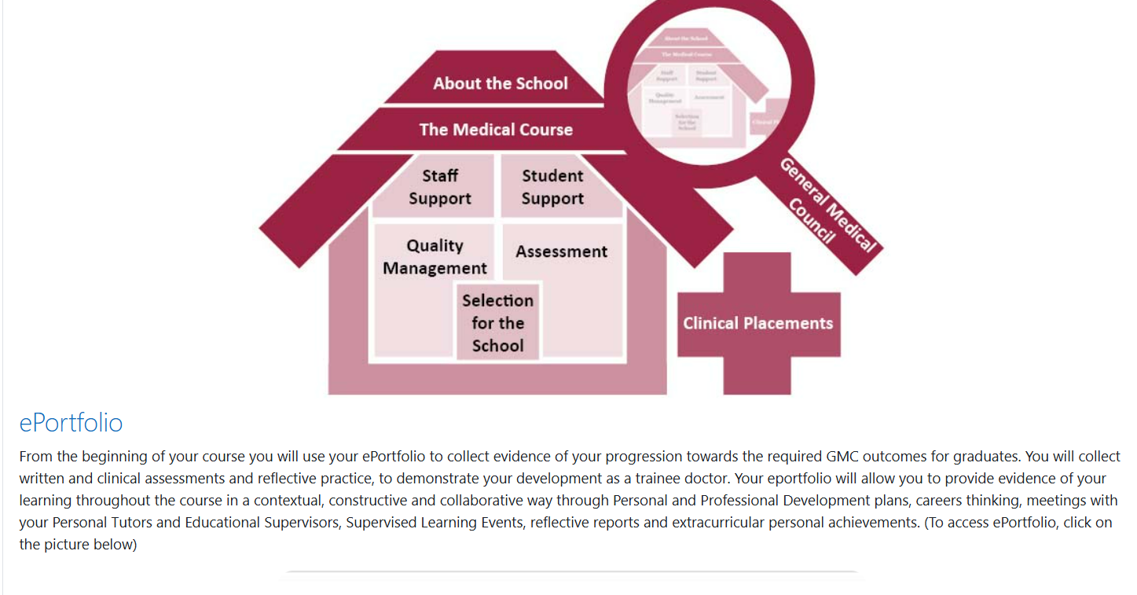
Accessing the ePortfolio

Slide 5
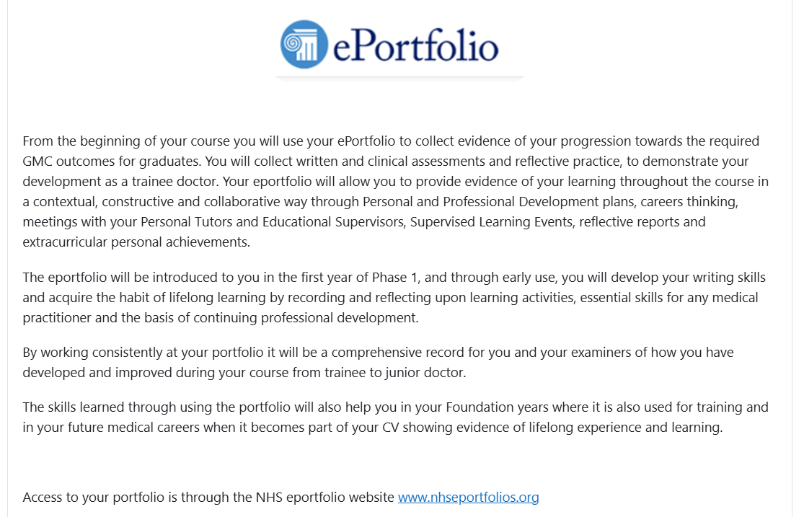
Moodle ePortfolio Page

Slide 6
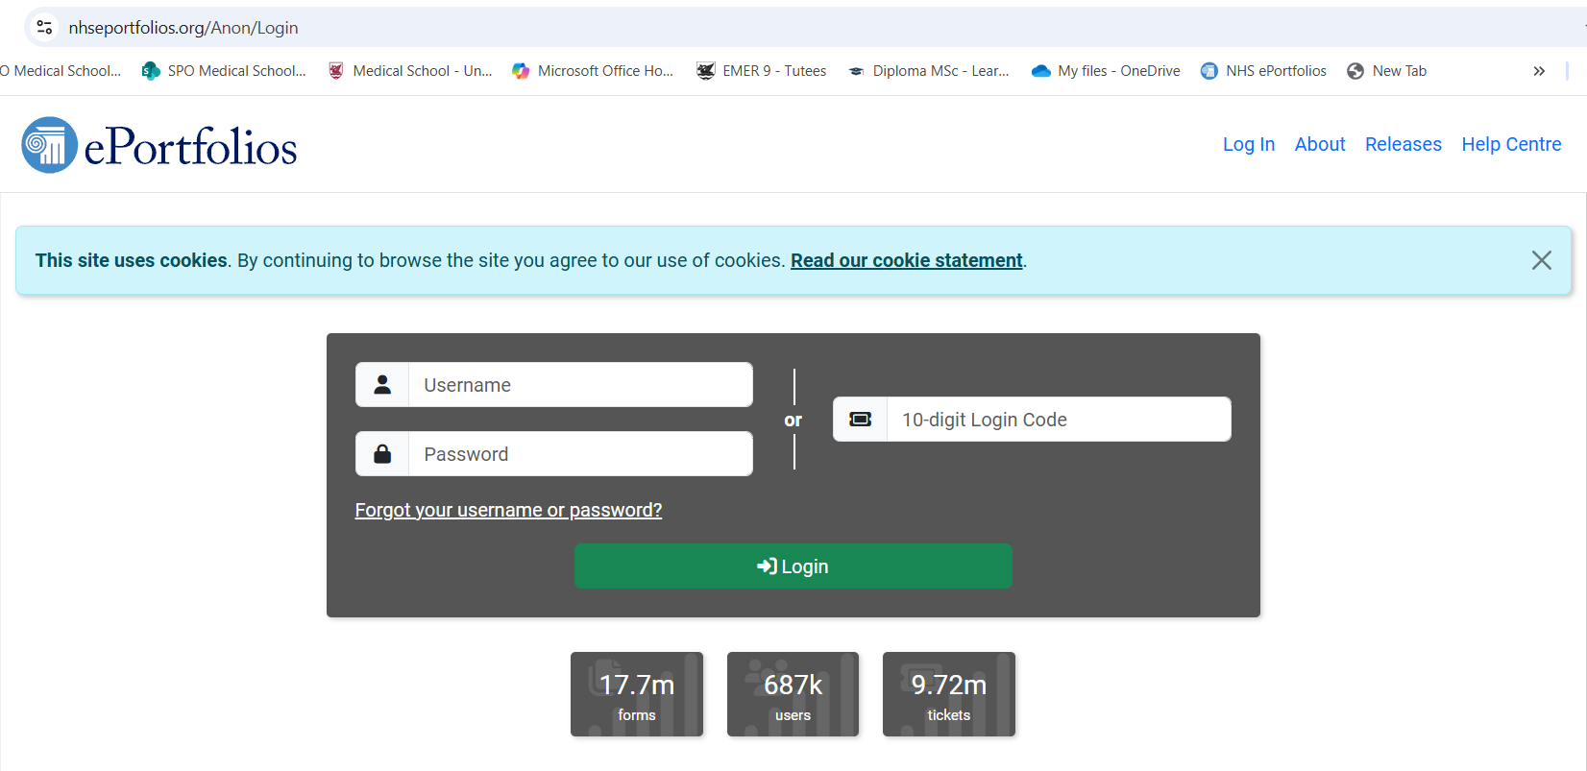
ePortfolio

Slide 7
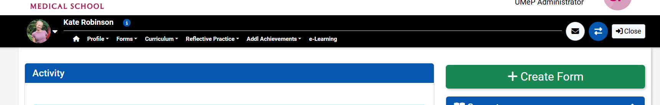
Navigating the Portfolio

Slide 8
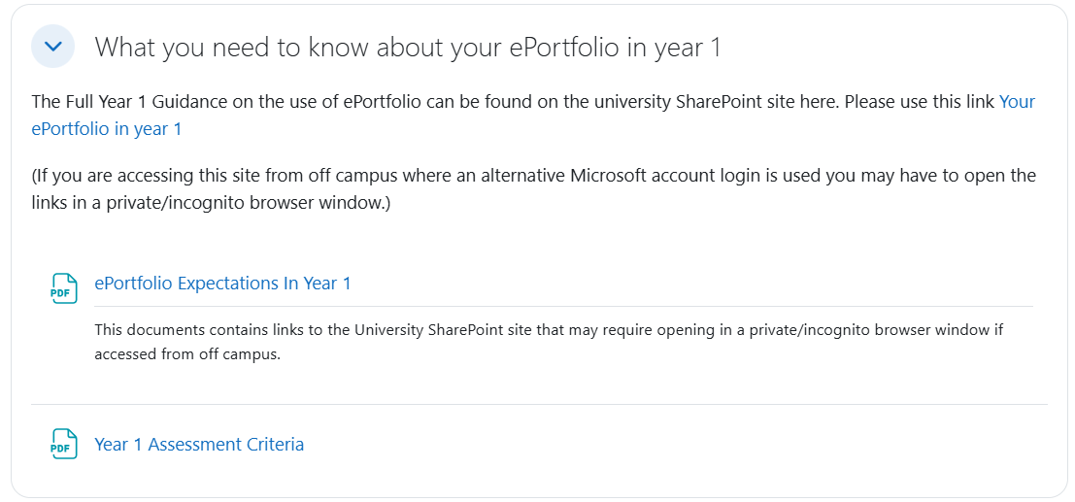
ePortfolio in Year 1(Moodle)
Link to SharePoint
Downloadable ARPP1 minimum requirements
Assessment Overview

Slide 9
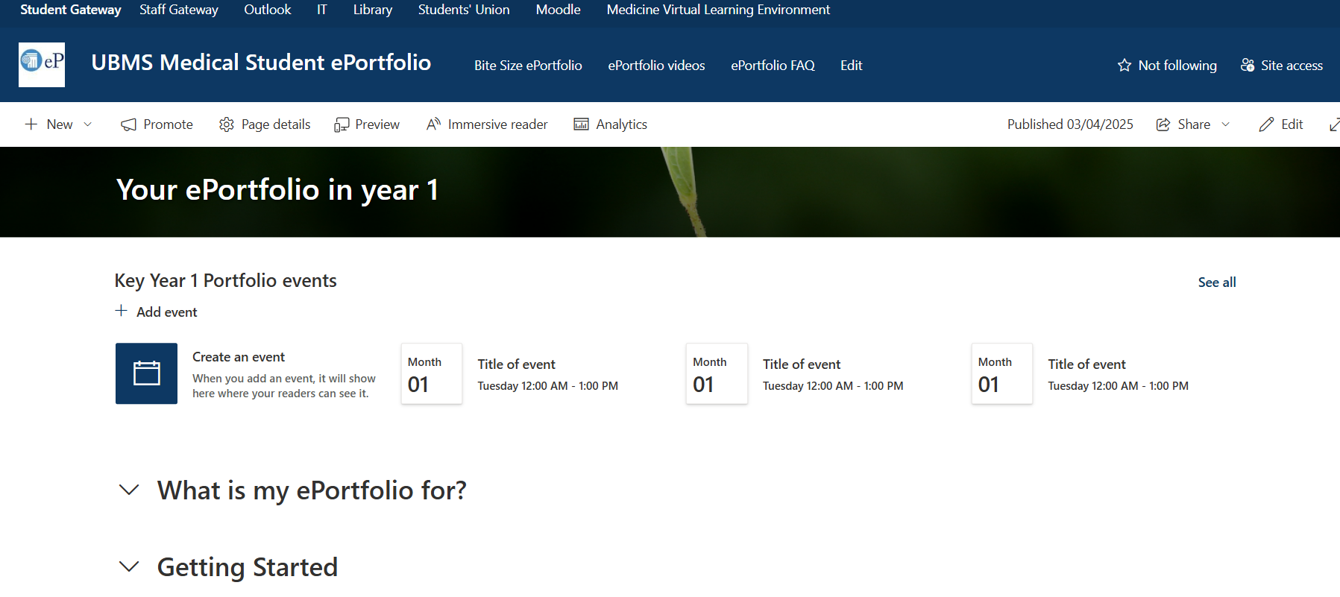
SharePoint

Slide 10
ARPP1
Provisional submission date: 23:59 5th October
ARPP1 results will be released on Examsoft
Remember ARPP1 is a formative process!
If you have not met the minimum requirements, you will receive an email from the ePortfolio team, outlining what is missing and suggested “remediations” to bring your portfolio up to the expected standard
Notes:
When the ARPP1 results are released you will be able to log onto Examsoft to view your feedback. This is in the form of a rubric, with the boxes relevant to your work highlighted. Please note that ARPP1 is a formative process, and as such there is no Pass (satisfactory) or Fail (unsatisfactory), and the outcome will not directly affect your progression on the course. Instead, you will see whether you met all the minimum requirements as set out on Moodle, as well as gain an idea of where your strengths lie and where you may need to focus on areas to improve. Please read the content of the highlighted rubric boxes carefully – they will tell you where you have most likely excelled or “gone wrong”, and where you may need to focus your efforts for next year’s ARPP. You may find some comments in the comments boxes, if the marker assigned to your ePortfolio felt that more specific/detailed feedback was required. If you have been marked as not meeting minimum requirements, you will receive an email from the ePortfolio team outlining what was found to be missing, and the suggested “remediations” required to bring your ePortfolio up to the expected standard. In phase 1, whilst the process is formative, it is up to you if you wish to act on these suggestions

Slide 11
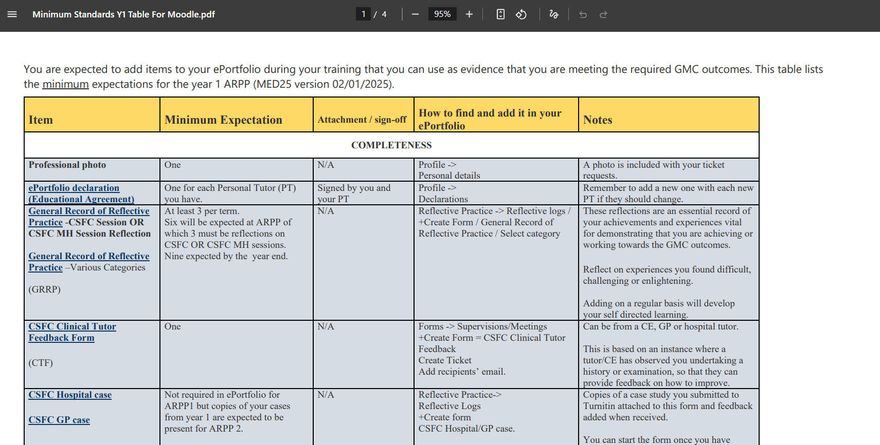
Minimum Expectations for ARPP1
Hyperlinks to SharePoint
Available on SharePoint and Moodle

Slide 12
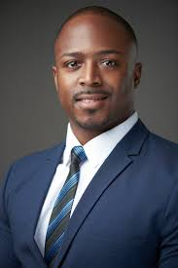

Professional Photo

Slide 13
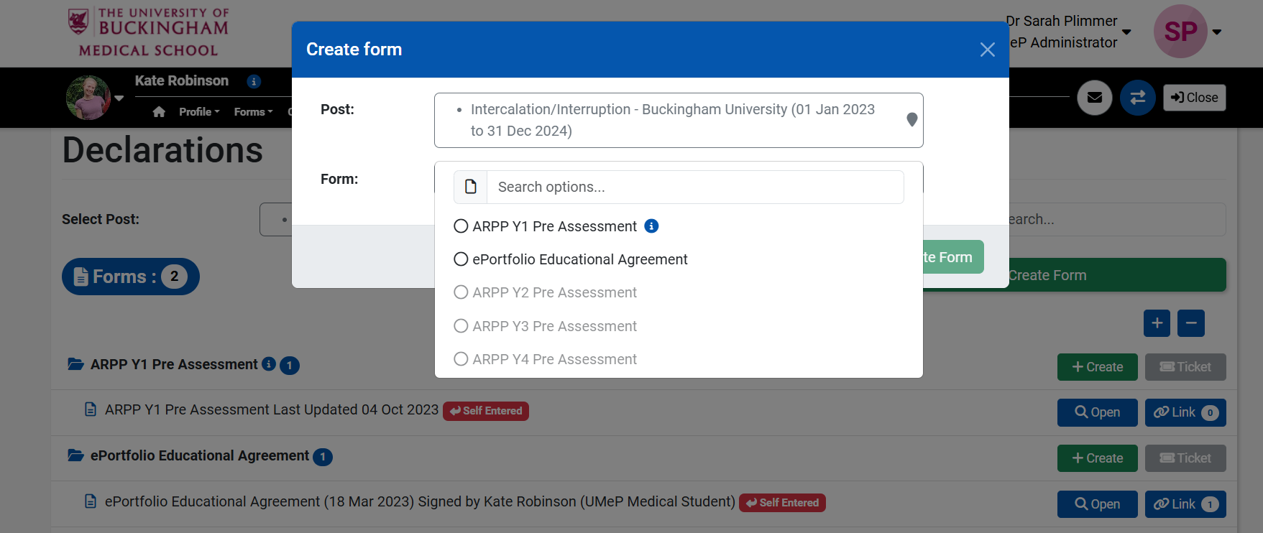
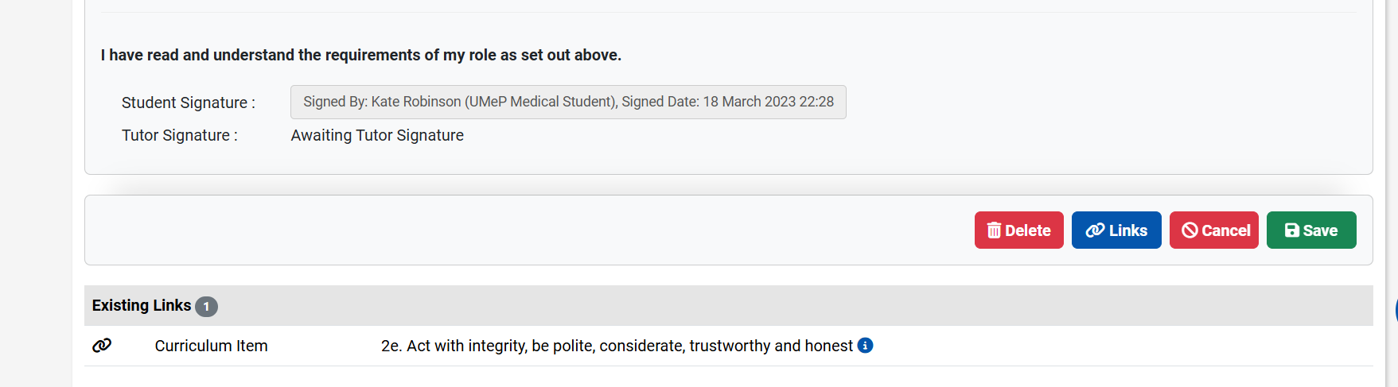
ePortfolio Declaration
Term 1
Sign yourself and ask personal tutor to sign
Remember to add one for each new PT if they should change

Slide 14
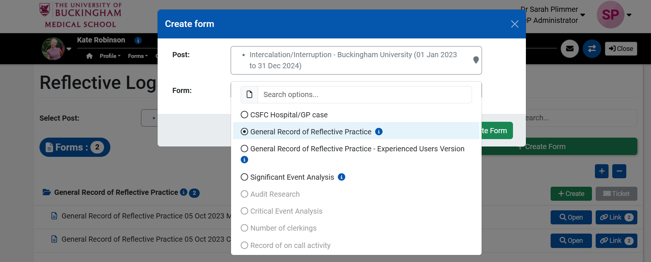
General Reflections
At least 3 per term (Should have at least 3 by now!)
6 expected by ARPP1
3 must be on CSFC or CSFC MH sessions
9 expected by end of year

Slide 15
Tips for Reflection
Use a framework (What? So What? Now What?)
Reflect on learning experiences that have impacted you.
  Depth of reflection important – “I thought…” “I felt…..
  Consider situation from other perspectives also increases reflection depth
Create SMART learning plans from reflections (which can be added to your PDP)
Reflections must be anonymised from ANY INFORMATION that could identify persons involved.

Slide 16
CSFC Tutor Feedback
Can be from a CE, GP or hospital tutor within a standard CSFC session
Based on an instance where a tutor/CE has observed you undertaking a history or examination, so that they can provide feedback on how to improve
Minimum expectation for ARPP1: 1 completed form
How to add to ePortfolio
  Forms -> Supervisions/Meetings +Create Form = CSFC Clinical Tutor Feedback
  Create Ticket
  Add recipients’ email

Slide 17
CSFC Hospital and GP Case
Recent format change – MINIMUM REQUIREMENT DOC TO BE UPDATED!
Formative assessment weeks 9-11 Term 3 CSFC (start thinking about cases now!)
Each student will have a 30-minute case-based discussion with CE
  15 minutes hospital case
  15 minutes GP case
Feedback will be provided via a CSFC Tutor Feedback Form – Select appropriate options (Hospital /GP case option)
Hospital and GP case CSFC tutor feedback forms will NOT be counted as CSFC tutor forms for ARPP1

Slide 18
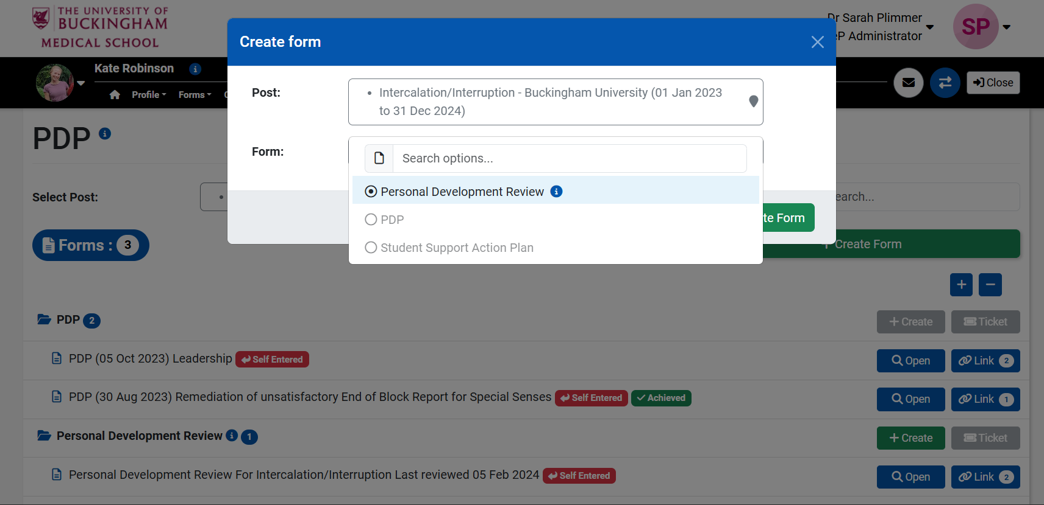
Personal Development Review
Start in Term 1 – update throughout the year
For ARPP all Part 1 sections must have content and Part 5 record at least 2 dates of PT Meetings.
Notes:
Reflective Practice -> PDP +Create form Personal Development Review
Start a new one at the beginning of each academic year. Return and update during the year. Review with your personal tutor. Part 1 assessment section expected to cover ETA 1 & 2 when done, other assessments optional.
ALL PDR Form Part 1 sections to have content by the Year 1 ARPP.
PT to add link signature to lock form after last meeting of academic year. This may be after the ARPP.

Slide 19
Personal Development Plan (PDP)
Start in Term 1
Create a new PDP for each goal
PDP Goals:
  Should not relate to the core curriculum or mandatory training
  Can also add non-academic PDP
  Should be SMART format
ARPP minimum expectation: 1
How to complete:
  Reflective Practice -> PDP +Create Form Personal Development Plan
Notes:
Start a PDP at the beginning of the academic year. Your PDP goal should not relate to the core curriculum or mandatory training (perhaps expand on something you’ve covered on the course). You may add more than one PDP If you also add a Non academic PDP this year only do one. Review and mark when achieved

Slide 20
Early Years TAB Exercise
You will be told by email when to start the process (1 completed expected for ARPP1)
You must do the self-TAB first
Send tickets to all your members of your small working group
When you have 4+ response ask you PT to create and release the anonymous summary
TO START: Forms -> Early Years TAB Forms Self TAB +Create Form
TO TICKET: Forms -> Early Years TAB Forms Outstanding Tickets +Create Ticket
Notes:
You will be told via email when to do this. You must do the self-TAB first. Send tickets to all your members of your small workgroup. When you have at least 4 responses from your tutor group peers you must ask your PT to create and release the anonymous summary. A 2nd eyTAB may be requested if there is a problem highlighted – if this has been requested by your PT, you should aim to complete this before the ARPP. A Concern as referenced in this early years TAB exercise is not an officially actionable notice but a matter of comment that may be considered
TO START: Forms -> Early Years TAB Forms Self TAB +Create Form TO TICKET: Forms -> Early Years TAB Forms Outstanding Tickets +Create Ticket

Slide 21
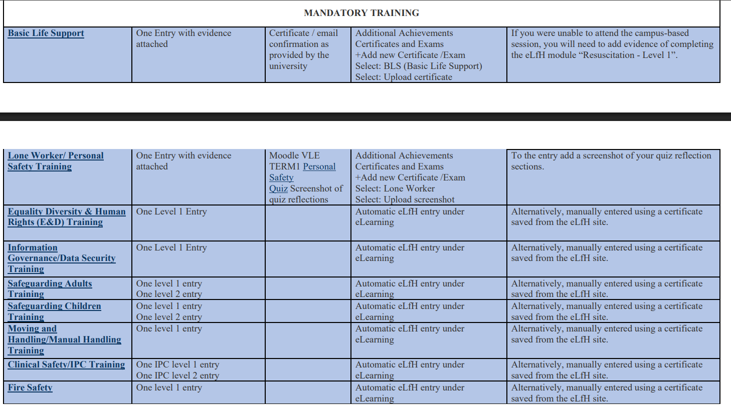
Mandatory Training

Slide 22
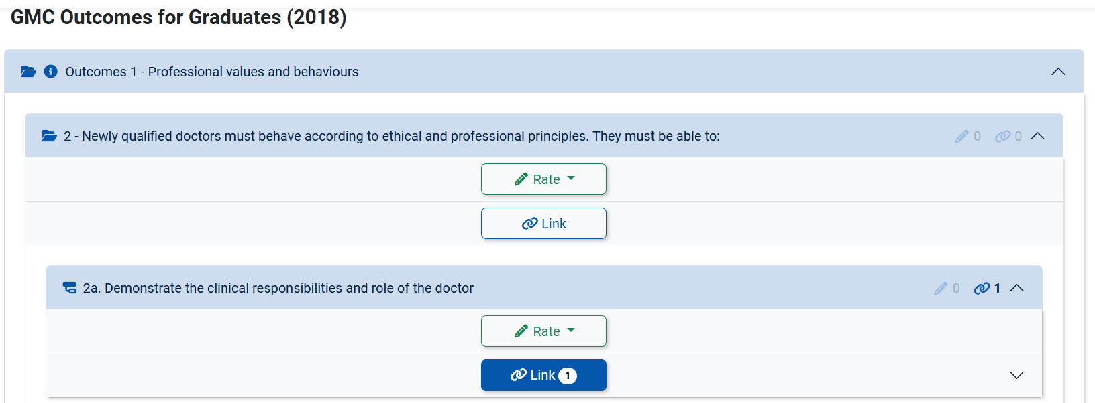
GMC Linking
GMC outcomes 1 - Professional values and Behaviours
Sub-outcomes 2- 9
Need to link best piece of evidence to 28 of 56 sub outcomes
No item of evidence to be used for more than 3 outcomes.
Notes:
Curriculum / GMC Outcomes for Graduates (2018) / Outcomes 1 - Professional values and behaviors. Section 2-9 All Sub outcomes.

Slide 23
Student Lead Practical Procedures (StOPPS)
By ARPP 1 you should have one self reflection and one peer observation StOPPs for at least 4 of the following key procedures:
  Baseline physiological observations
  Peak expiratory flow respiratory function test
  Ophthalmoscopy
  Otoscopy
  Urine multi dipstick test
  12-Lead ECG
  Take and/or instruct patients how to take a swab.
  Instruct patients in the use of devices for inhaled medication.
Notes:
STOPPs form can be completed either as a self-reflection (complete the form yourself), OR a peer observation (send a ticket to whoever has observed you student or CE).
For the 8 key procedures both are required.
The most likely STOPPs you will be able to complete for ARPP1 are; 1) baseline obs, 2) PEFR, 9) urine dipstick, 11) swabs and 15) inhaler devices.
You may add StOPPS forms for other procedures you have been taught and practiced.

Slide 24
Student Lead Practical Procedures (StOPPS)
How to create from
  Forms -> Procedures +Create Form
  Select: Student Observation of Practical Procedural Skills (StOPPS) Form
  Create form (self assessment) OR Create Ticket (peer assessment)
Notes:
STOPPs form can be completed either as a self-reflection (complete the form yourself), OR a peer observation (send a ticket to whoever has observed you student or CE).
For the 8 key procedures both are required.
The most likely STOPPs you will be able to complete for ARPP1 are; 1) baseline obs, 2) PEFR, 9) urine dipstick, 11) swabs and 15) inhaler devices.
You may add StOPPS forms for other procedures you have been taught and practiced.

Slide 25
Additional Achievement
Not list on minimum expectations however are part of marking rubric for ARPP
Covers evidence of any academic or non-academic activity outside of course
Upload evidence of any additional achievements in the additional achievements section of the portfolio

Slide 26
Example of Interaction With ePortfolio
Term 1
Professional photo
Term 2
Reflect on exam performance in PDR/reflection
3 reflections
Term 3
Reflect on exam performance in PDR/reflection
1 PT meeting and PDR entry
Create PDR + PDP
3 reflections
2nd PT meeting and PDR entry
Mandatory training modules
Create new PDP
Create new PDP
3rd PT meeting and PDR entry
CSFC Hospital and GP Case.
ARPP1 Preassessment form
Declaration
PDR, PDP, upload evidence of training/certificates, CSFC tutor feedback, TAB exercise, STOPPS, GMC linking
Notes:
Interact with PDR/PDP throughout the year
Upload evidence of training/certificates/non-academic achievements
Upload at least 1 CSFC tutor feedback form
Engage with the TAB exercise – you will be sent an email about this

Slide 27
Tips for ARPP1
Please make sure all forms you wish to put forward for assessment are viewable - forms in "DRAFT" are not visible to markers and will not be counted.
Make sure you have completed all fields of your year 1 Personal Development Review form, including your brief notes from any PT meetings you have had this year. Your PT will document their notes in a different software and may choose to add a brief comment within your PDR form in the space provided.
Make sure you ask your PT to release your early years TAB summary to you well in advance of the submission deadline so that you can reflect on the comments made.
Notes:
Phase 2 ePortfolio ARPP is a summative process, and students tend to fair better when they have taken time and effort to "practice" within the formative Phase 1 process. A few tips:

Slide 28
Tips for ARPP1
Make sure you ask your PT to go through your completed PDR form so that you can tick the declaration and then they can sign and lock the form
When you think you have completed all minimum requirements, please complete an "ARPP Y1 Pre Assessment" form - there is a checklist which you can use to cross-reference with
PLEASE ONLY TICK THE FINAL DECLARATION IF YOU DEFINITELY HAVE ALL ITEMS WITHIN YOUR EPORTFOLIO
Notes:
Make sure you ask your PT to go through your completed PDR form so that you can tick the declaration and then they can sign and lock the form
When you think you have completed all minimum requirements, please complete an "ARPP Y1 Pre Assessment" form - there is a checklist which you can use to cross-reference with
PLEASE ONLY TICK THE FINAL DECLARATION IF YOU DEFINITELY HAVE ALL ITEMS WITHIN YOUR EPORTFOLIO - students who falsely declare missing items will not be put forward for marking and this may constitute a professionalism concern. We strongly suggest you do 2 and 3 by mid September at the latest (remember, your PT may be on leave if you leave it too near to the deadline!).

Slide 29
med-eportfolio@buckingham.ac.uk

