Slide 1
How to upload NM and SSC Assessments

Slide 2
Your lead/supervisor will tell you exactly what and how to submit your assessments. (Ignore any dates on auto generated emails from Examsoft)

Slide 3
You will have at least one piece of written work to upload

Slide 4
You will be asked to submit the file(s) to TurnItIn first for a plagiarism check. The link is on the NM or SSC moodle page. Then you will submit them to Examsoft for marking. This guidance is about Examsoft.

Slide 5
You must work through either firefox or chrome

Slide 6
Your username is your 7 digit ID number: e.g. 1234567 Your password is issued to you in an email when you are setup in Examsoft by the assessment team. The SSC files must be named using the following protocol: [Your ID number] [SSC name] [Assessment type] e.g. 1234567 Medical Humanities Poster Narrative Medicine must be: [ID#] Narrative Medicine dissertation [condition] You may upload any of the common file types You must keep a copy.

Slide 7
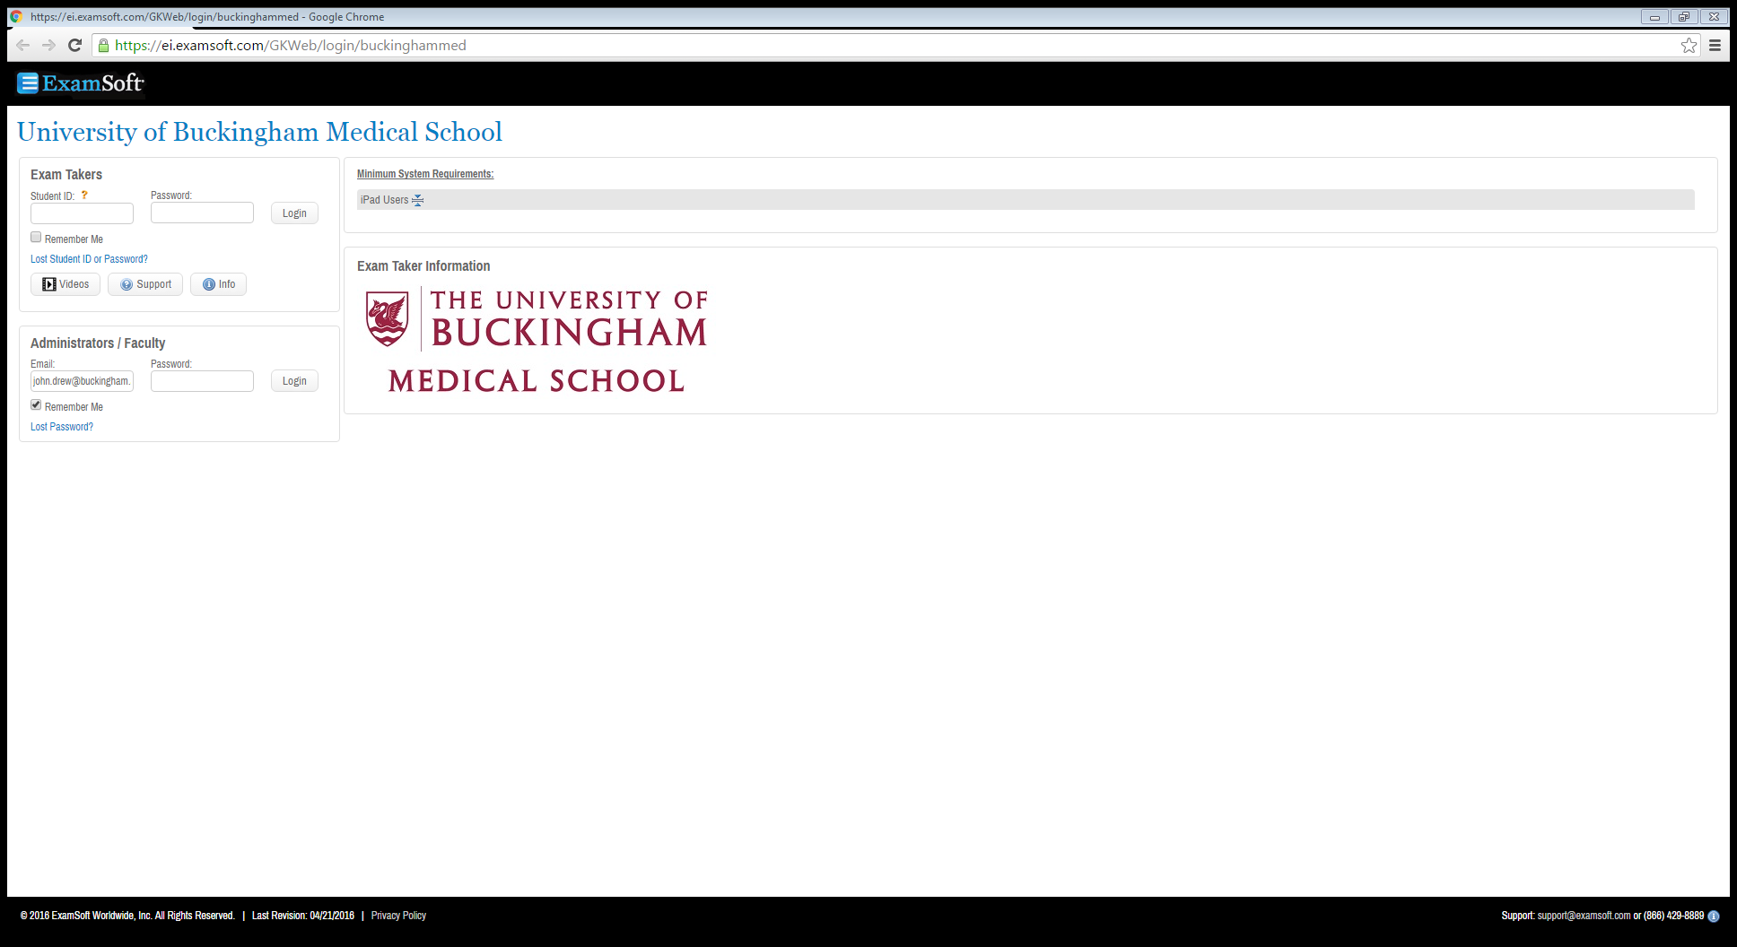
https://ei.examsoft.com/GKWeb/login/buckinghammed

Slide 8
Select courses from the black bar near the top of the page

Slide 9
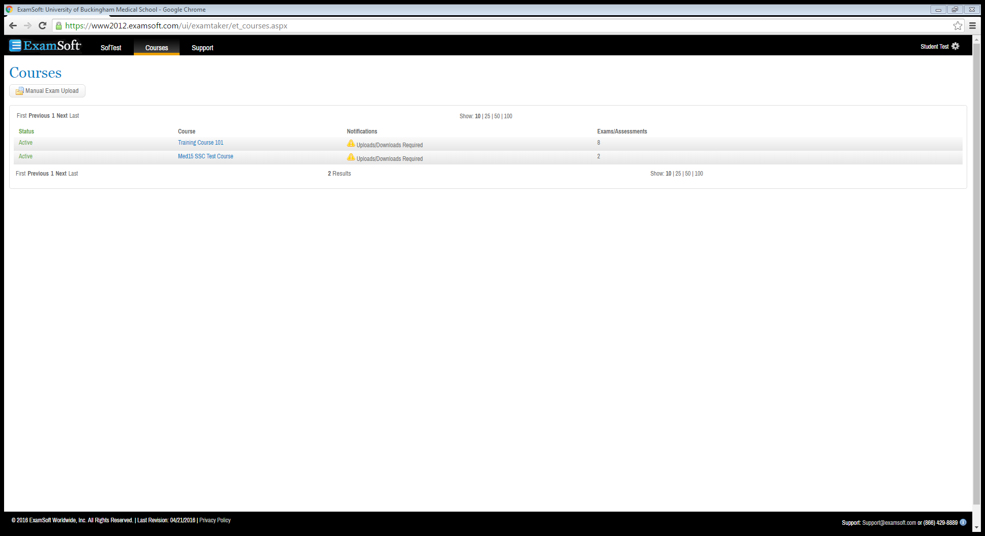
Click on your NM or SSC

Slide 10
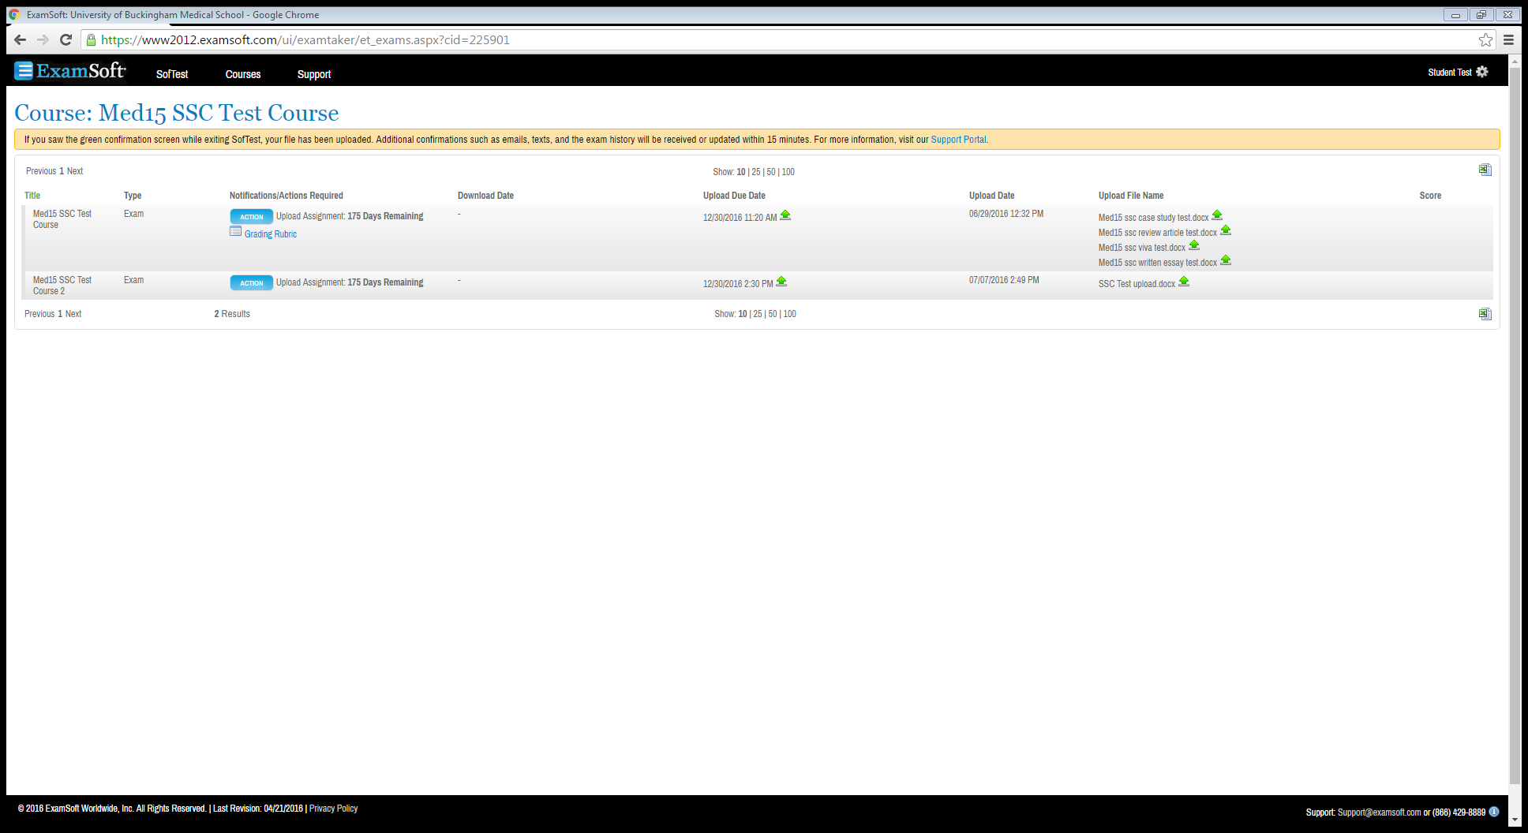
Click on the blue action button. (After you have uploaded files you will be able to see them here)

Slide 11
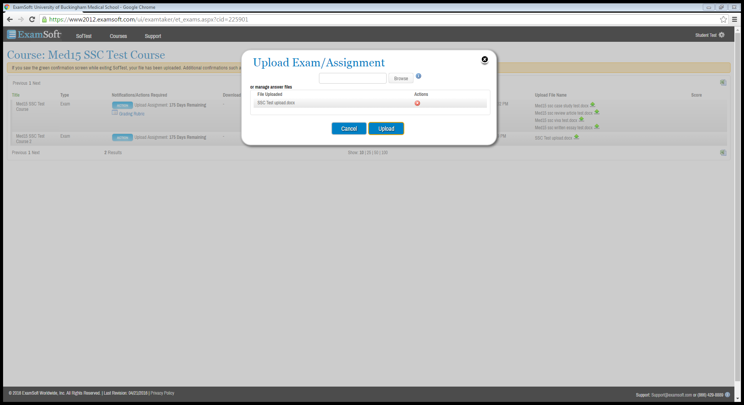
Upload the file from this window.

Slide 12
Prior to the deadline, you are able to delete files by using this red cross.

Slide 13
Files
Nearly all file types are supported
There is a 10mb manual upload file limit for all file types
For larger files, such as videos, contact the assessment team to allow a link.
Students then upload the video file to google drive or some other storage software (Dropbox, s3, etc.)
Students can then link the video of whatever size there and it’ll be viewable in the grading window just like a normal uploaded file is.

Slide 14
If you need to resubmit a piece of work, there will be a new link posted. Please make sure your file is easily identifiable from the file name e.g. 1234567 RESUBMISSION [NM or SSC] [name of part being resubmitted]

Slide 15
The instructions are on the assessment page on moodle

